Slide 1
CS 4032 – Web Programming
Dr. Hassan Sartaj

Slide 2
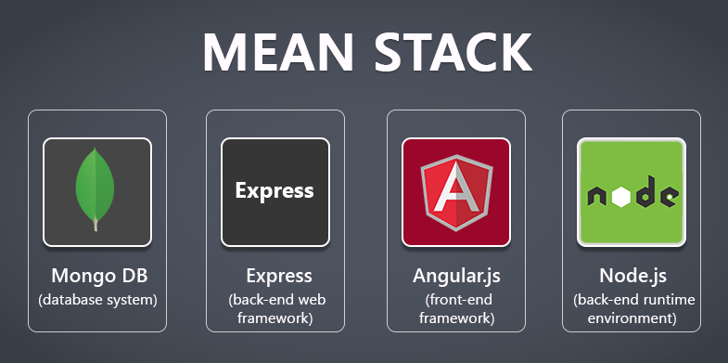
Collection of JavaScript based technologies used to develop web applications.

Slide 3


Slide 4
What is NoSQL ?
Not SQL, Not Only SQL, Not Relational
A term that describes a class of data storage and manipulation technologies and products that do not follow the RDBMS principles and focus on large datasets, performance, scalability, and agility

Slide 5
Types of NoSQL Databases
Key-Value Stores
Amazon DynamoDB
Column Family Stores
Apache HBase
Graph Databases
Neo4j
Document Databases
A document in a document database consists of a loosely structured set of key-value pairs.
MongoDB

Slide 6
A "Document" Example
{
"first_name": "John",
"last_name": "Doe",
"age": 20,
"address": {
"street": "123 Main"
"city": "Los Angeles"
"state": "CA"
}
}
It's basically JSON
Why is it called a document, not an object??
Notes:
MongoDB stores data records as BSON documents. BSON is a binary representation of JSON documents, though it contains more data types than JSON.

Slide 7
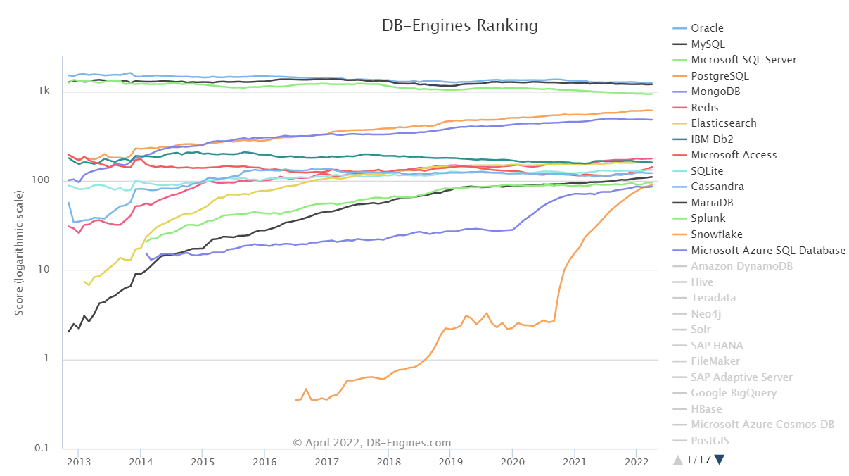
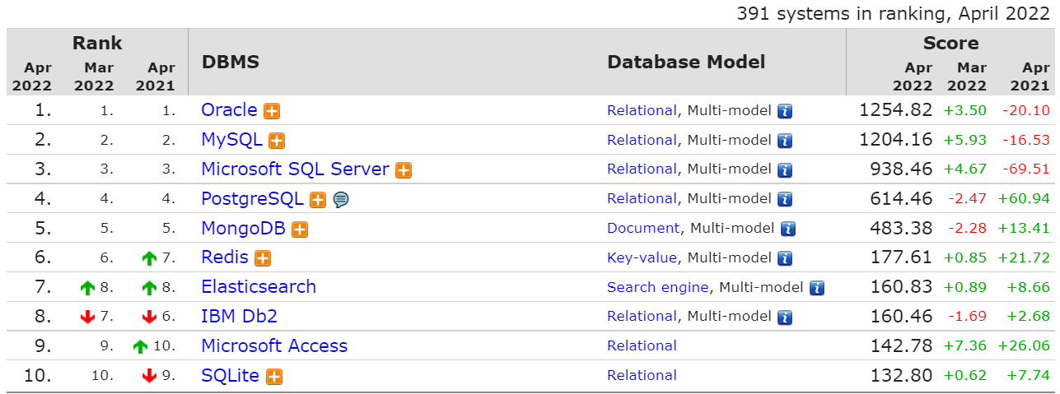
DBMS Popularity
DB-Engines.com
Ranking
Trend

Slide 8
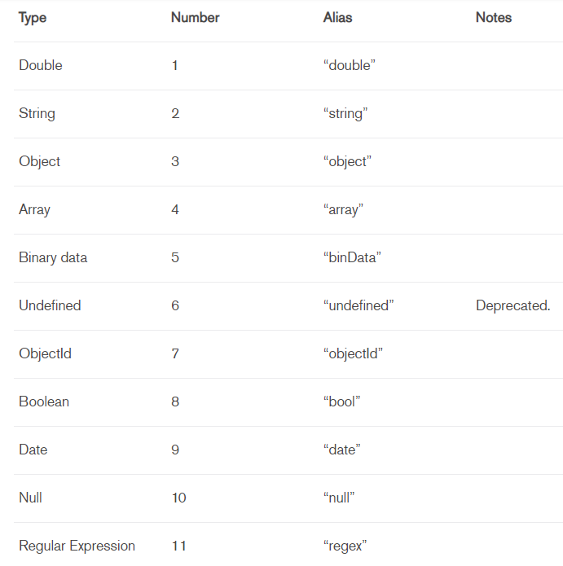

MongoDB
The most popular NoSQL database
Document database
BSON data types
The "M" in MEAN/MERN stack

Slide 9
MongoDB Installation
Install MongoDB Community Edition
No security by default
Localhost binding (default since 3.6)
Install MongoDB Compass
MongoDB Windows Installer installs Compass by default

Slide 10
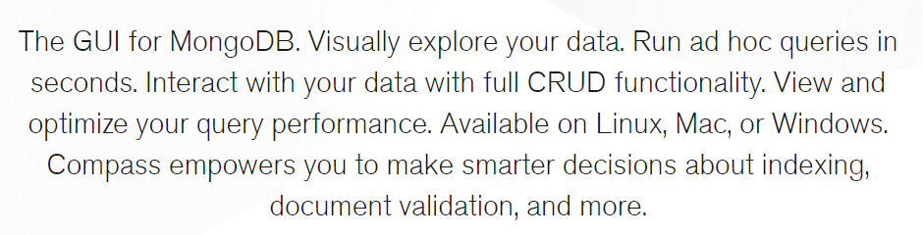
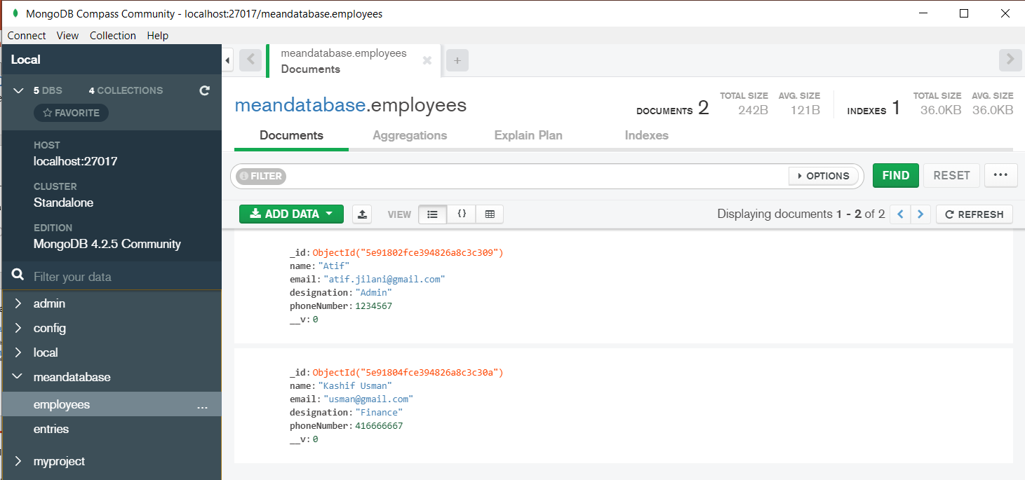
Basic Usage of MongoDB Compass
Connection
Create databases and collections
Document CRUD

Slide 11
MongoDB Server
DB
Collection
document
document
DB
document
Collection
Collection
Database
A collection is the equivalent of a table in relational databases
Collection does not enforce a schema

Slide 12
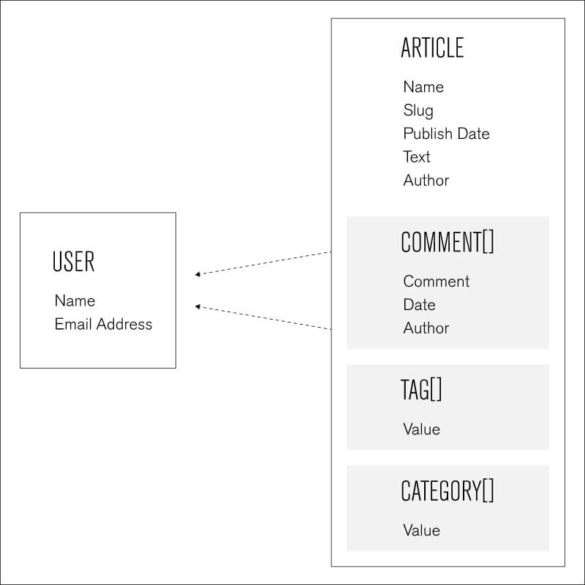
Blog Example
Users
Articles
Comments
Tags
Notes:
Let’s use a database schema example from a blogging application to help illustrate the document model in MongoDB. For the blog, you could model the data as two collections -- one to represent visitors and the other for the articles. Each document of this blog database could contain multiple comments, multiple tags, and multiple categories, each expressed as an embedded array.

Slide 13
Data Modeling
Understand MongoDB data types
Knowledge of relational modeling still applies
To embed or not to embed: that is the question

Slide 14
Data Modeling (I): Data Types
Numbers
Boolean, Integer, Double, Decimal
Text and binary data
String, Regular Expression, Code, Binary Data
Date and timestamp (for internal use)
Special types
Null, Min/Max Key, ObjectId
Object and Array

Slide 15
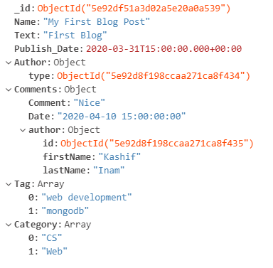
A MongoDB Document …

Slide 16
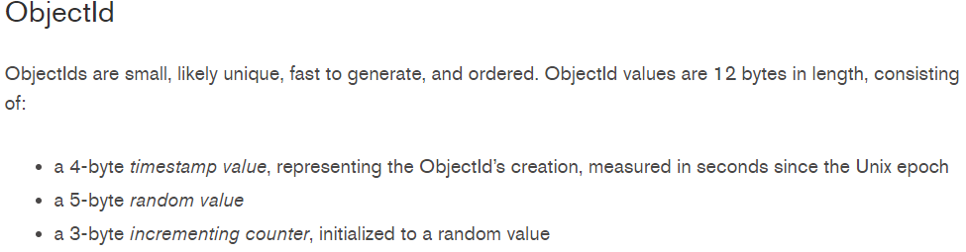
… A MongoDB Document
Each document must have a unique _id field that serves as the primary key
The value of _id can be user-assigned (of any type) or auto-generated (of ObjectId type)
An Object value is also known as an embedded document or a sub-document

Slide 17
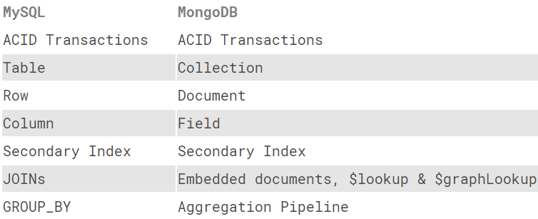
Data Modeling (II)
All the relational design
knowledge still applies
Entities and relationships
Tables ➔ collections
With that said, document databases are not relational databases
Doing JOIN is difficult
Does have much richer data types

Slide 18
Data Modeling (III)
To embed or not to embed: that's the question
Article
Comment
Comments[]
Or
Article
Tags[]
Tag

Slide 19
Embed Or Not Embed
Read performance vs data redundancy
Basically the same arguments as normalized data vs de-normalized data in relational design
Examples:
Article and article author
Comment and comment author
Atomicity requirements

Slide 20
Need for Transactions …
Not all operations can be done with a single operation, e.g. transferring money from one bank account to anther:
-- 1. Check the balance of account #1
select balance from accounts where id = 1;
-- 2. Withdraw $100 from account #1
update accounts set balance = balance – 100
where id = 1;
-- 3. Deposit $100 to account #2
update accounts set balance = balance + 100
where id = 2;

Slide 21
… Need for Transactions …
Bad things could happen due to concurrent access and/or system failure
The other owner of the
joint account withdraws
all the money in
account #1
-- 1. Check the balance of account #1
select balance from accounts where id = 1;
-- 2. Withdraw $100 from account #1
update accounts set balance = balance – 100
where id = 1;
-- 3. Deposit $100 to account #2
update accounts set balance = balance + 100
where id = 2;

Slide 22
… Need for Transactions …
Bad things could happen due to concurrent access and/or system failure
-- 1. Check the balance of account #1
select balance from accounts where id = 1;
-- 2. Withdraw $100 from account #1
update accounts set balance = balance – 100
where id = 1;
-- 3. Deposit $100 to account #2
update accounts set balance = balance + 100
where id = 2;
The other owner of the
joint account checks the
balances of both
accounts and notices
that $100 is missing

Slide 23
… Need for Transactions
Bad things could happen due to concurrent access and/or system failure
-- 1. Check the balance of account #1
select balance from accounts where id = 1;
-- 2. Withdraw $100 from account #1
update accounts set balance = balance – 100
where id = 1;
-- 3. Deposit $100 to account #2
update accounts set balance = balance + 100
where id = 2;
System crash

Slide 24
Transaction and ACID
A transaction in RDBMS is a group of SQL statements treated by the DBMS as a single unit of work
Transactions in RDBMS are ACID
Atomic
Consistent
Isolated
Durable

Slide 25
Transactions in MongoDB
Write operations are atomic on the level of a single document
Multi-documents transaction support
Since 4.0 (6/2018) - MongoDB supports multi-document transactions on replica sets.
Since 4.2 (8/2019) - MongoDB introduces distributed transactions, which adds support for multi-document transactions on shared clusters and incorporates the existing support for multi-document transactions on replica sets.
Since 4.4 (9/2020) - MongoDB allows creating collections and indexes inside of a multi-document transaction (implicitly or explicitly)

Slide 26
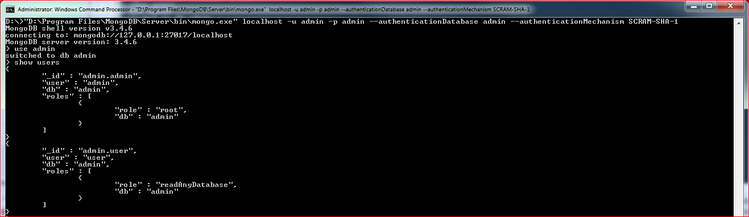
MongoDB Shell
mongo
A command line client that provides an interactive JavaScript interface to MongoDB

Slide 27
Basic MongoDB Shell Commands
help
show dbs
use <db>
Switch to database <db>
<db> won’t be created until some data is inserted into it
show collections
db.dropDatabase()

Slide 28
MongoDB's Query Language
JavaScript with MongoDB methods
Some collection methods:
db.<collection>.insert()
db.<collection>.find()
db.<collection>.update()
db.<collection>.remove()
db.<collection>.drop()
SELECT * FROM inventory WHERE status = "A" AND qty < 30
const cursor = db.collection('inventory').find({
status: 'A',
qty: { $lt: 30 }
});
await db.collection('inventory').updateOne(
{ item: 'paper' },
{
$set: { 'size.uom': 'cm', status: 'P' },
$currentDate: { lastModified: true }
}
);
await db.collection('inventory').insertOne({
item: 'canvas',
qty: 100,
tags: ['cotton'],
size: { h: 28, w: 35.5, uom: 'cm' }
}
);

Slide 29
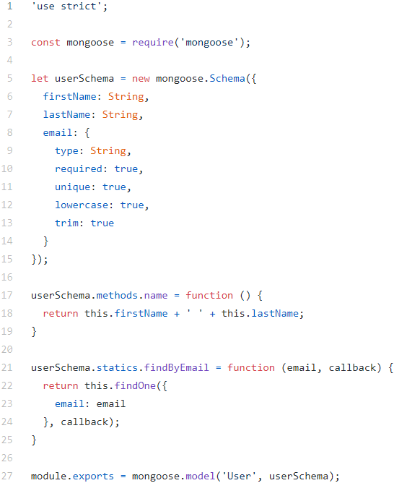
Example of Basic Operations
Create a database test1 and a collection User
Create two documents Atif and Hassan
Save the two documents to a collection User
List the documents in the collection
await db.collection('User').insertMany([
{ firstName: 'Atif’, lastName: 'Jilani', email: 'atif.jilani@nu.edu.pk' },
{ firstName: 'Hassan’, lastName: 'Sartaj', email: ‘hassan.sartaj.v@nu.edu.pk' }
]);

Slide 30
Using find()
find( [query], [projection] )
Query tutorials
Query operators
Examples using the Blogs database
SELECT * FROM User WHERE Name = “Hassan” AND email=“hassan.sartaj@nu.edu.pk”)
const cursor = db.collection('User').find({
$and: [{Name: ‘Hassan' }, { email: 'hassan.sartaj@nu.edu.pk'}] });
const cursor = db.collection('User').find({}).project({ firstName: 1, _id: 0, });

Slide 31
Queries (I) Basic Conditions and Projections
List all users
List the first name of all users
Without _id
Find the users whose last name is Sartaj
Using comparison operators
const cursor = db.collection('User').find({});
const cursor = db.collection('User').find({}).project({ Name: 1, _id: 0, });
const cursor = db.collection('User').find({Name: ‘ Hassan Sartaj '});

Slide 32


Queries (II) Logical Operators
Find the users whose first name is John and last name is Doe
Implicit and explicit $and
Find the users whose first name is John or last name is Doe
Find the users whose first name is John or (the first name is Jane and the last name is Doe)
SELECT * FROM User WHERE firstName = “Hassan " AND email=“hassan.sartaj@nu.edu.pk”)
const cursor = db.collection('User').find({
$and: [{firstName: ‘Hassan' }, { email: 'hassan.sartaj@nu.edu.pk'}]
});

Slide 33
Queries (III) Arrays and Sub-documents
Find the articles whose tags contain "NoSQL"
Using $all
Find the articles commented on 04-12-2020 with comments “Interesting”
db.articles.find( { Tag: { $all:["NoSQL"] } } )
db.collection('Article').find( {
Comments: { $all: [ { $elemMatch :
{ Comment:"Interesting", Date:"04-12-2020" }
} ]
}
} )

Slide 34
Queries (IV) Join
const docs = await db.collection('Article').aggregate([
{
$lookup: {
from: 'User',
localField: 'Author',
foreignField: '_id',
as: 'user'
}
}
{
$unwind: '$user'
},
{
$project: {
_id: 0,
Author_Name: '$user.Name',
Author_Email: '$user.email',
Title: 1,
Tag:1,
publishDate: 1
}
}
]);
List the articles with their authors (i.e. not just author id)
db.<collection>.aggregate()
$lookup
List the article authors
$project

Slide 35
Update and Delete
db.<collection>.update( query, update, options )
db.<collection>.remove( query, update, options )
Change Hassan Sartaj's name to Atif Jilani
$set
Other update operators
Delete the article "Using MongoDB"
Add a tag "Tutorial" to the article "Programming Node.js"
$push
Delete the comments made by John Doe
$pull

Slide 36
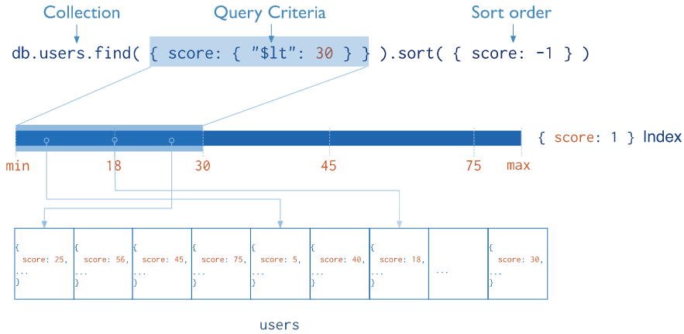
Indexing
Indexes are crucial for performance just like in RDBMS
db.<collection>.createIndex(<keys>, [options])
keys: {field: -1|1, field2: -1|1, …}
options: unique, name, …
Notes:
Indexes support the efficient execution of queries in MongoDB. Without indexes, MongoDB must perform a collection scan, i.e. scan every document in a collection, to select those documents that match the query statement. If an appropriate index exists for a query, MongoDB can use the index to limit the number of documents it must inspect.

Slide 37
Index Examples
Ascending order
db.users.createIndex({lastName: 1});
db.users.createIndex({email: 1}, {
unique: true,
name: 'EmailIndex'
});
db.articles.createIndex({tags: 1});
Index on array field

Slide 38
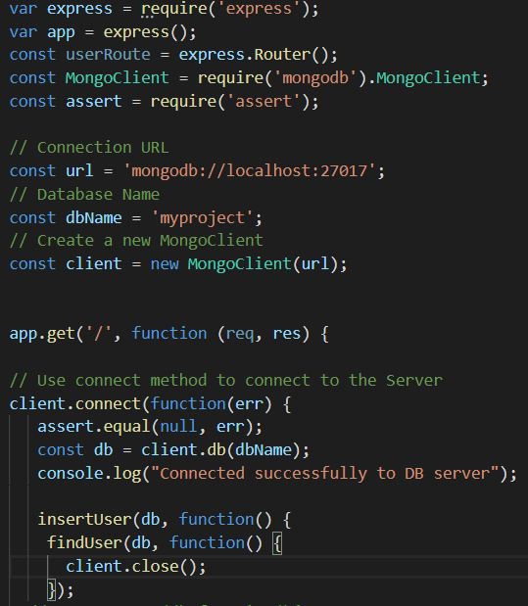
MongoDB with Node.js
MongoDB Node.js driver
Mongoose
Model classes
Validation
DAO methods

Slide 39
Using MongoDB Driver
npm install mongodb
Understand the API
Connection string format
MongoClient, Db, Collection, Cursor

Slide 40
About Using MongoDB Driver
Difference between Node.js code and MongoDB shell script
MongoClient maintains its own connection pool – reuse the same client/db/collection as much as possible before closing it

Slide 41
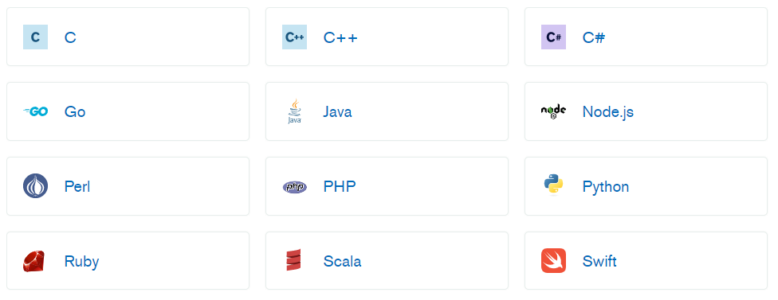
Support for Other Programming Languages
Drivers for various server-side programming language – https://docs.mongodb.org/ecosystem/drivers/

Slide 42
NoSQL vs Relational …
NoSQL databases are designed to be easier to scale horizontally
Document databases make data modeling easier and data access more efficient for certain applications
Using one language (i.e. JavaScript) for everything is appealing
But …

Slide 43
… NoSQL vs Relational
Giving up ACID, SQL, and tried-and-true reliability of RDMBS is no small sacrifice
Scalability and performance of RDBMS have continued to improve
Understanding application requirements and data modeling is important for both
Use the right database for the right job

Slide 44
Readings
MongoDB Manual
MongoDB Node.js Driver
Why SQL is beating NoSQL

Slide 45
Thank you!

